Slide 1
Elon Musk
Entrepreneur Profile

Slide 2
Who is Elon Musk?
He is the founder, CEO, and CTO of SpaceX
Co-founder, CEO, and product architect of Tesla Inc
.
Co-chairman of OpenAI
Founder and CEO of Neuralink

Slide 3
Entrepreneurial qualities embodied by Musk
Imagination
Persistence
Perseverance

Slide 4
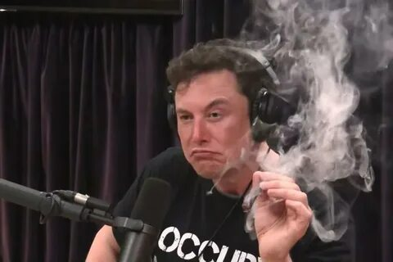
Chronological table of events
1983: At age 12, creates and sells video game for $500.
1999: He and his brother sell their first company, Zip2, for $300 Million
2002: Sells Paypal to Ebay for $1.5 Billion, that same year founds SpaceX
2004: Invests in Tesla Motors
2008: Becomes Tesla CEO
2013: Develops Hyperloop concept
2015: Announces creation of OpenAI
2016: Announces Boring Company

Slide 5
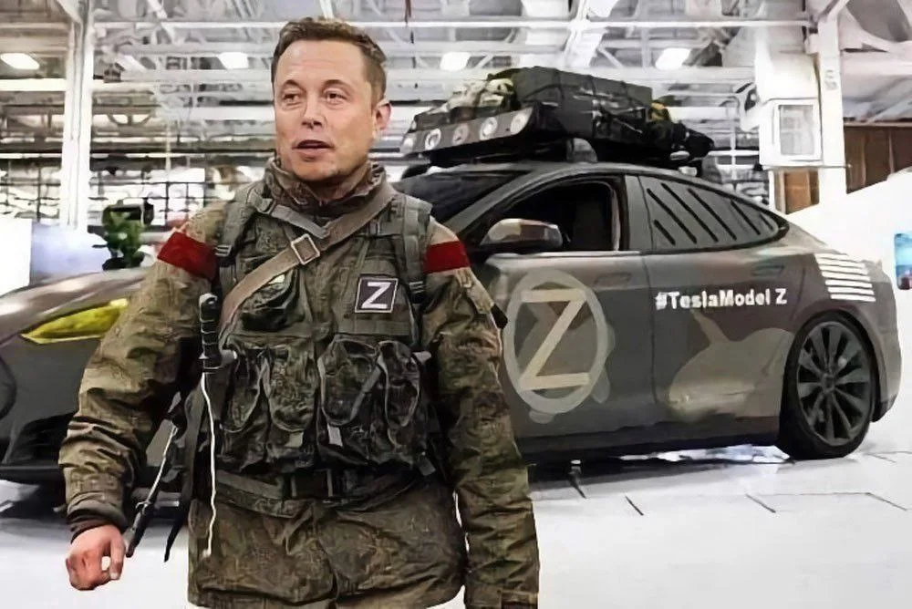
Forbs
As of April 2025, Elon Musk is the richest man in the world.
His fortune, according to the editors of Forbes magazine, amounted to 342 billion dollars.
On January 7, 2021, Elon Musk became the richest man on the planet, displacing Amazon founder Jeff Bezos to second place in the Forbes ranking. Musk's fortune at that time was estimated at 185 billion dollars.

Slide 6
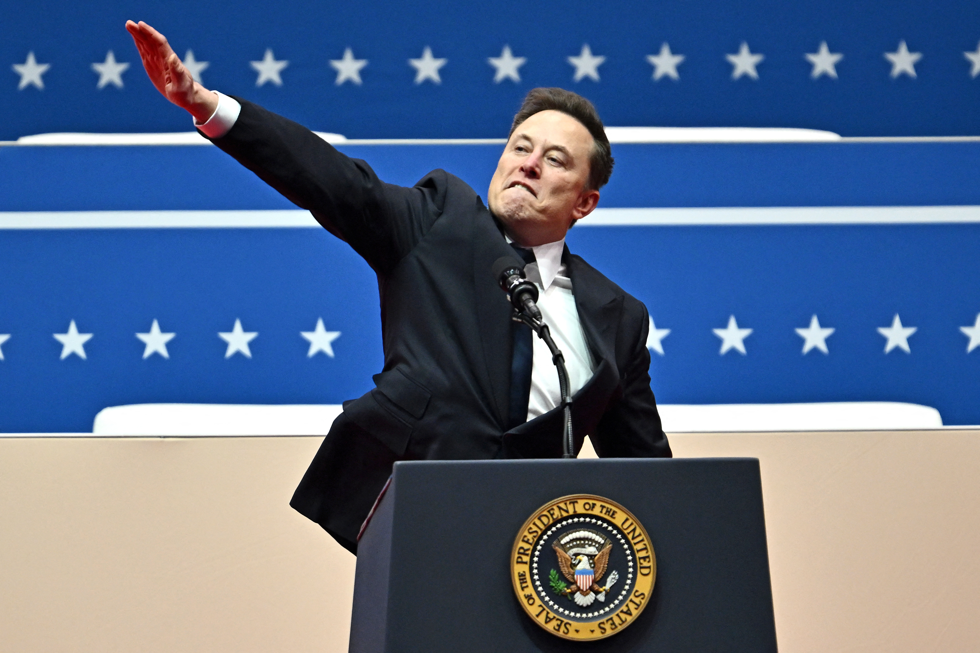
Politics
On October 6, 2024, Elon Musk spoke for the first time at an election rally in support of presidential candidate Donald Trump.
The businessman called for voting for the former head of the White House, otherwise, according to him, this will be the last election in the United States, and Trump must win in order to preserve the Constitution and democracy in the country.

Slide 7
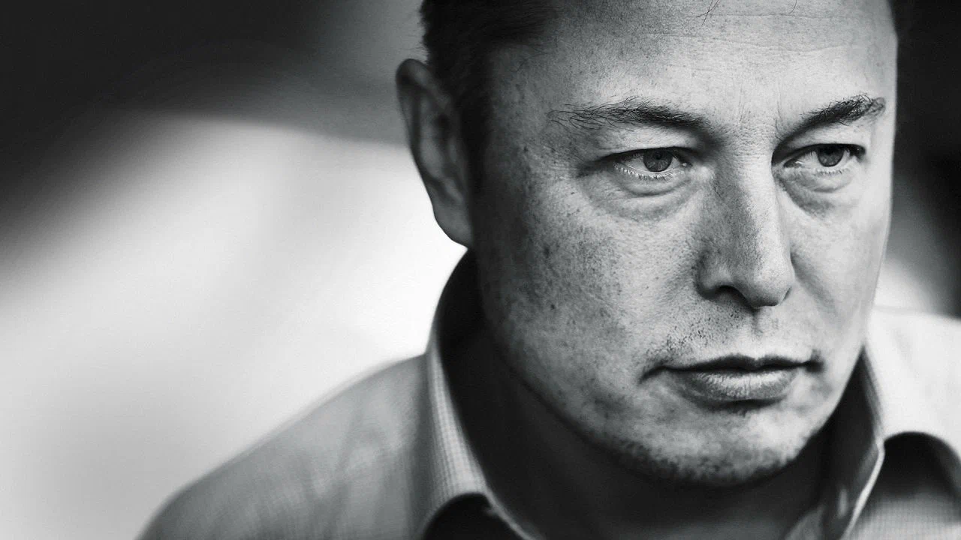
Close relatives
May Musk, Elon's mother, is also a well-known public figure, a successful model, lecturer and nutritionist.

Slide 8
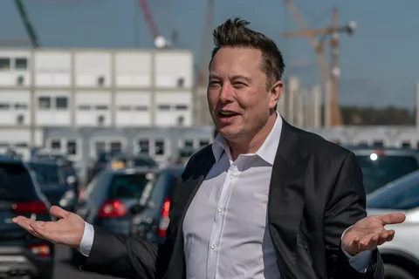
The End

